Slide 1

Data Visualization and Communication Project I: Dementia Deaths Greece v. Europe Part II: Interactive Plots
Eirini Mylona

Slide 2
Interactive and Dynamic Plots
In this part, we are going to explore the dementia cases across the Europe, and more specifically the dementia deaths per 100,000 total deaths for males and females in an interactive way. The interactive plots have been created on Tableau.
The information provided from the dataset used for this part is represented below.
Country
Dementia deaths
Total Deaths
Data
Age Group
Gender
Year
Dementia Deaths per 100K Total Deaths

Slide 3
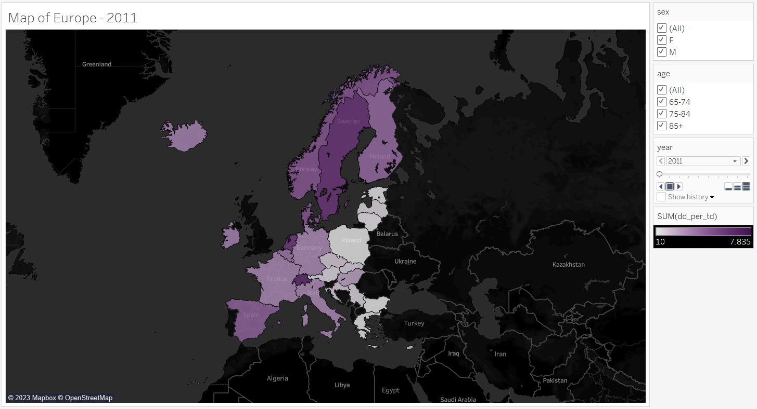
Map
In the adjacent map, the countries we are interested in are color-coded. The color on this particular map acts as a heatmap. The darker the color, the more deaths from dementia per 100K total deaths the corresponding country had. This diagram is interactive. The user is given the ability to select the year of interest, the gender, and the age group through filters. Additionally, they have the option to choose more than one category per filter. What is more, a slider has been added so that the user can have the ability to better perceive the changes in the death rate for each country across the years under study.
As for Greece, once again we observe that deaths from dementia per 100Κ total deaths are relatively low compared to the rest of Europe while the death rate seems to increase over the years.

Slide 4
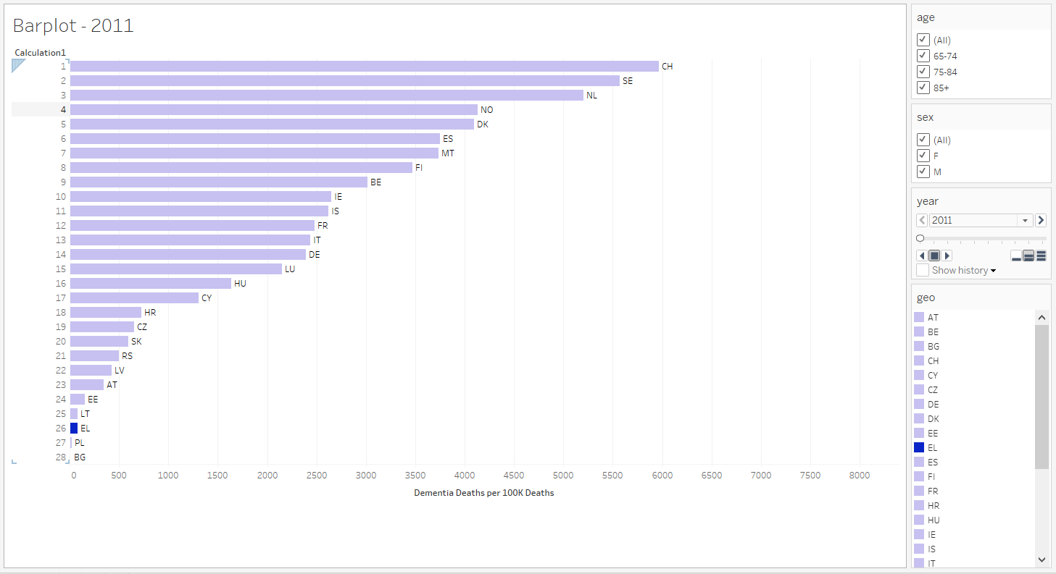
Dynamic Barplot
The second interactive plot is a dynamic barplot. The countries we are studying are placed on the y-axis, while the number of deaths from dementia per 100K deaths is on the x-axis for each country. In this diagram, the user has the ability to select the year they want to study, as well as the gender and age group. In each filter, they can select more than two categories again. Moreover, a slider has been added so that the user can have the ability to better perceive the changes in the death rate for each country across the years under study. Also, the bars are sorted dynamically in descending order, allowing the user to compare more easily, whereas Greece is colored in blue for easier comparison.
We observe that Greece has a low death rate when compared to other European countries. However, there is an increasing trend over the years for both males and females.

Slide 5
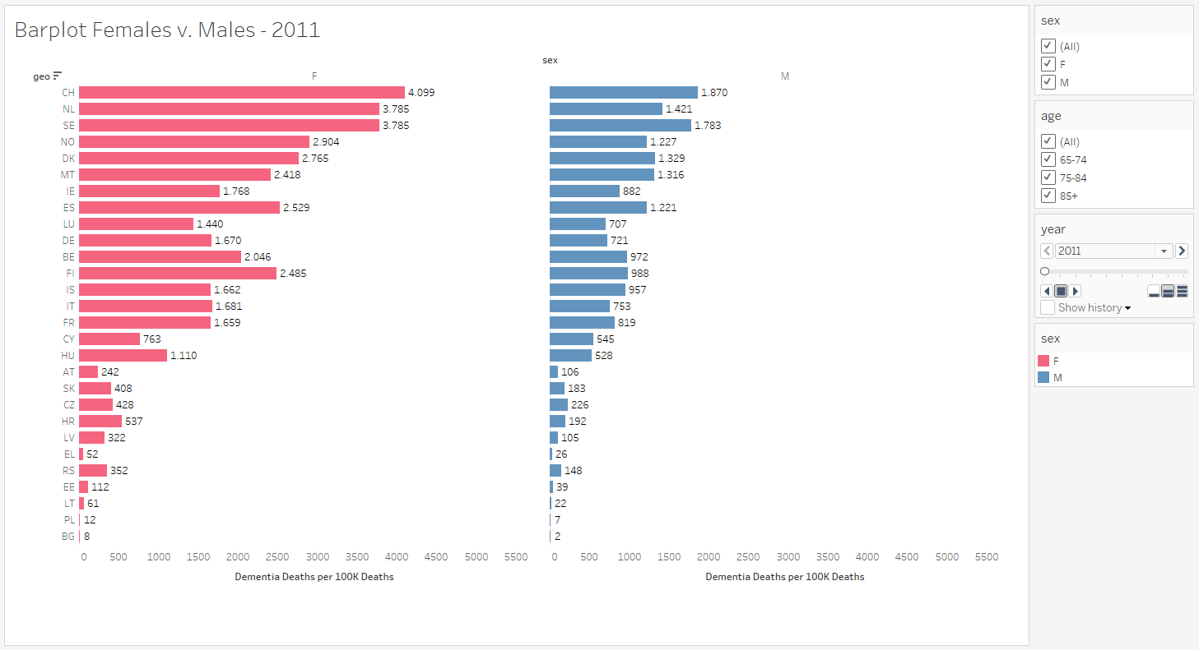
Barplot Females v. Males
On the interactive barplot located on the right, users can compare dementia death rates per country, as well as filter the data by gender and age group. The filters allow for the selection of multiple categories simultaneously.
When examining the data for Greece, it becomes apparent that the dementia death rate exhibits an upward trend over the years. This increase is not limited to a specific gender or age group but applies to both males and females, as well as all age groups combined. The barplot enables users to explore and compare these rising death rates in Greece with other countries while adjusting the slider to visualize the changes more effectively and therefore verify these results themselves.

Slide 6
Conclusions
The conclusions derived from the interactive graphs are the same as those from the corresponding static ones, as expected.
The difference is that the interactive graphs give the user the ability to extract specific segments of interest by selecting their preferred filters. This allows them to examine these segments separately while also viewing them as a whole.

